Slide 1
Quick Phone
Sprint 1 Presentation
Repair Scheduling & Parts Inventory System
MIS 4173 System Analysis & Design
Team: Bara Abusamhan, Ehsanullah Pardisi, Kyle Robertson, Leonard Mann

Slide 2

Problem
Quick Phone is a phone repair business in Raleigh, NC.
Ashiqullah Pardisi is the owner of the business
Has a manual/analog system to manage repair intake, scheduling, job status, and parts inventory.
Difficult to track open repairs, parts availability, and provide customers with updates.
Quick Phone staff needs a digital system to help manage repair intake, scheduling, job status, customer updates, and parts inventory more efficiently.

Slide 3
Direction
Objectives: fewer status calls, fewer jobs stuck on parts, zero lost devices, one view across both stores
Check-in, repair tracking through pickup, parts inventory and purchase orders, dashboard, email alerts
No sensitive customer information (ID numbers), all staff must be authenticated, data encrypted in transit/in storage
Need to confirm who supports the system after handoff, baseline sales/call volume, user roles, workflow details, inventory rules

Slide 4
Value & Feasibility
Benefits staff at both stores, improves owner visibility, more transparency with customers
Estimated to decrease status calls −50%, jobs awaiting parts >5 days −50%, and zero lost devices
Estimate $8,952/yr returned vs. $1,550 one-time and $1,460/yr. Payback in ~2.5 months
Owner is project champion, <12 users, workflow unchanged

Slide 5
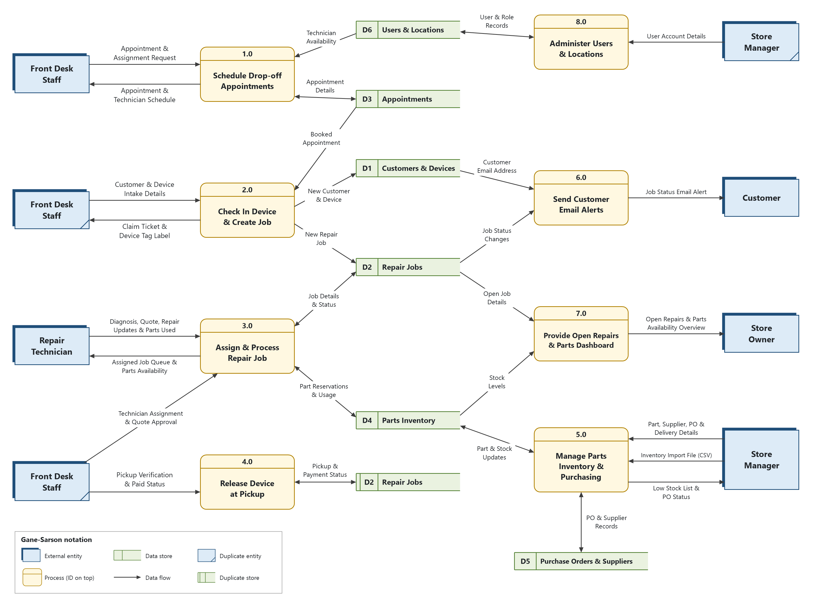

Slide 6
Thank you

